Slide 1
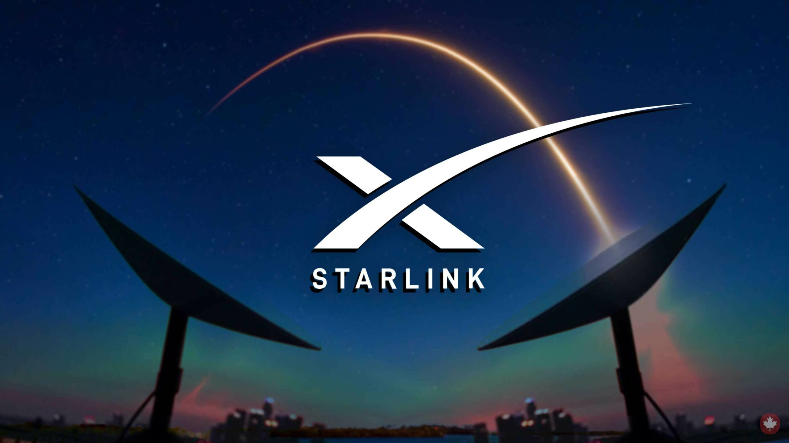

Slide 2
PRESENTED BY
SUHAIL K (MES21MCA-2056)
GUIDED BY
NOWSHAD CV
ASST.PROFESSOR
MES COLLEGE OF ENGINEERING KUTTIPPURAM

Slide 3

CONTENTS
What is Starlink ?
The need for satellite based internet
Current status and future plans
Working of Starlink
Advantages
Competition and Challenges
Conclusion
References

Slide 4

What is Starlink ?
4
Starlink is a satellite-based internet service provided by SpaceX.
Space x is a private aerospace manufacturer and space transport services company founded by Elon Musk.
It is a unique satellite-based technology, Starlink has the potential to revolutionize the internet industry and bring fast and reliable internet access to people in even the most remote regions around the world.

Slide 5

What is Starlink ?
5
Instead of using a couple of large satellites, Starlink uses thousands of small satellites.
Each satellite in this weights are just 260kg
Thousands of satellite will make up a network called Starlink.
Space X will fix its satellite in LEO (lower earth orbit) to provide faster internet speed.

Slide 6
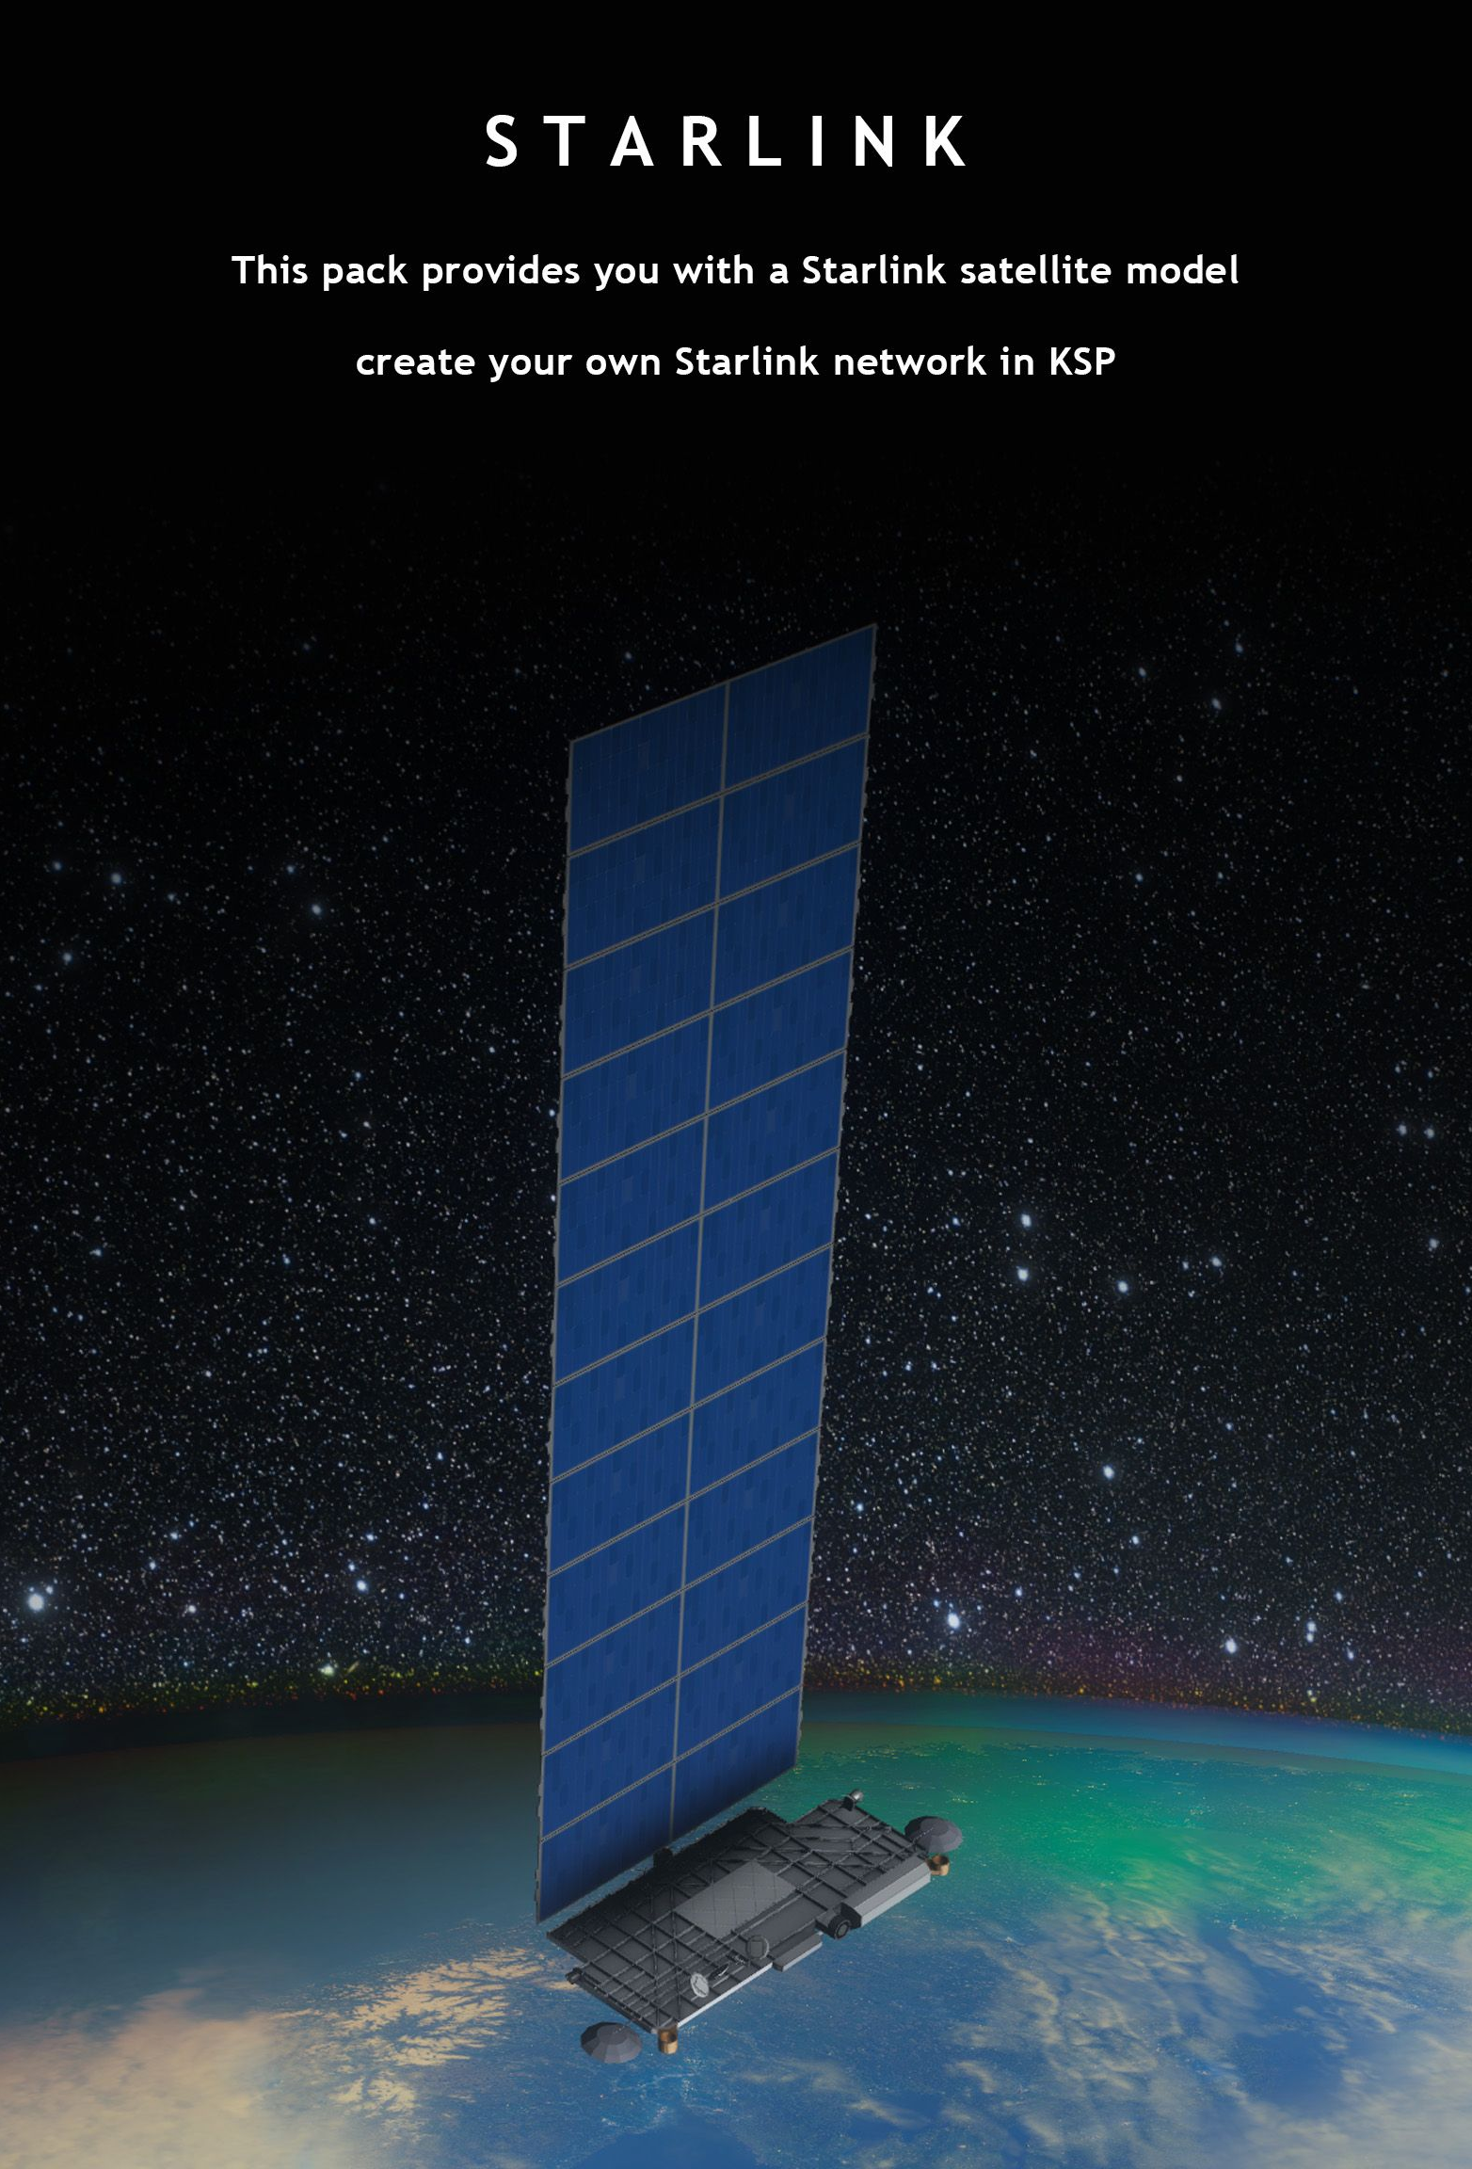
6
Starlink is provide high-speed internet access to remote and underserved areas around the world.
The service aims to deliver low-latency, high-speed internet connectivity that is comparable to or even better than traditional fiber optic-based internet services.
They launched their first satellite in 23 may 2019

Slide 7
Why we Need Satellite-Based Internet ?
7
The rapid growth of the internet and its widespread use.
Still millions of people in rural areas and developing countries still lack access to use internet services.
This has resulted in a digital divide between those who have access to the internet and those who do not, affecting their ability to participate in the modern economy and society.
Traditional fiber optic-based internet services, which rely on laying fiber optic cables to connect homes and businesses to the internet, are not always feasible or cost-effective in remote and rural areas.

Slide 8

WHY WE NEED A SATELLITE-BASED INTERNET ?
8
These areas often lack the infrastructure and population density to support the high costs of building and maintaining fiber optic networks.
Satellite-based internet offers a solution to this problem by providing a way to deliver high-speed internet access to remote and underserved areas.

Slide 9

9
The goal of Starlink is to create a low latency network in space that facilitates on Earth.
The challenge of creating a global network in outer space isn't a small one, especially because low latency is an important demand. SpaceX has proposed a constellation of almost 42,000 small-size satellites circling the globe in low orbit to meet this demand.
By using low-Earth orbit satellites, satellite-based internet services can reach areas where terrestrial internet services are not available, and provide a way for people in these areas to access the internet.

Slide 10
Current Status and Future Plans
10
Currently in the beta testing phase with limited access for selected users in the countries United States ,Canada,UK,France, Germany, Austria etc.
According to SpaceX CEO Elon Musk, the goal is to eventually provide coverage to the entire world.
SpaceX has also been working on improving the performance of the network by launching additional satellites and upgrading the user terminals.
The company has already launched over 3,055 small LEO (Low Earth Orbit) satellites and plans to launch thousands more in the coming years.

Slide 11
Current Status and Future Plans
11
Plans are for 42000 satellite in orbit in total.
Ones Planet mars is colonized Starlink will be deployed to provide service on mars
To support its plans for expanding coverage and improving performance, SpaceX has raised significant funding and secured partnerships with companies and organizations around the world.
The company has also been granted permission by the Federal Communications Commission to deploy up to 1 million user terminals in the United States.

Slide 12

12

Slide 13
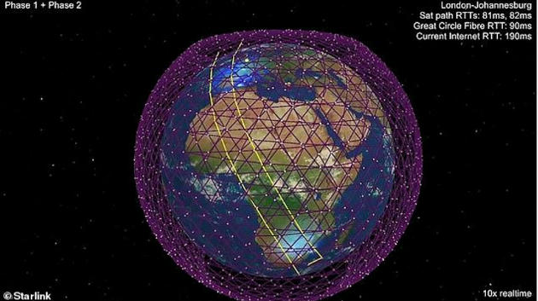
13

Slide 14
Working of Starlink
14
The satellites are positioned in orbit at an altitude of around 550 km, which allows them to provide low-latency, high-speed internet access to users on the ground.
▶ Satellites:

Slide 15

15

Slide 16
16
Design: Starlink satellites are compact and modular, with a design that allows for easy and cost-effective mass production.
They are about the size of a small car, and weigh approximately 227 kilograms.
The satellites are equipped with phased array antennas and powerful processors that allow them to communicate with each other and with ground stations.
The network uses adaptive beamforming technology to dynamically adjust the shape of the satellite beams to optimize coverage and performance.

Slide 17
17
The Starlink satellites are launched into orbit using SpaceX’s Falcon 9 rocket.
The Starlink satellites are deployed into orbit using a dispenser system on the Falcon 9 rocket.
Once in orbit, the satellites automatically deploy their solar panels and begin communicating with each other and with ground stations.
The Starlink satellites are designed to operate for several years in orbit, after which they will de-orbit and burn up in the Earth’s atmosphere.

Slide 18

18
Ground Stations: Starlink has a network of ground stations located around the world, which are used to communicate with the satellites and provide internet connectivity to subscribers.
These ground stations act as gateways between the satellite network and the terrestrial internet.

Slide 19

19
User Terminals: Subscribers receive internet access from Starlink through user terminals, which are
Small, dishes that are installed at the subscriber’s location. The user terminal communicates with the satellites in orbit and receives internet connectivity from the ground station network.

Slide 20
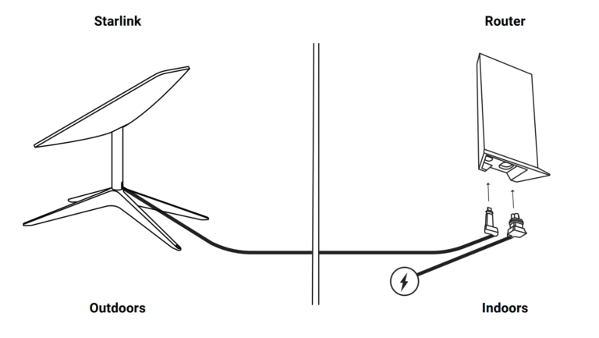
20

Slide 21
21
Network: The Starlink network is designed to be highly scalable, and the satellites are equipped with automatic routing algorithms that allow them to dynamically route traffic to ensure optimal performance.
Internet Access: Starlink delivers internet access to subscribers by transmitting data between the satellites, ground stations, and user terminals. The satellite network provides high-speed, low-latency internet connectivity to subscribers, allowing them to access the internet in even the most remote areas.

Slide 22
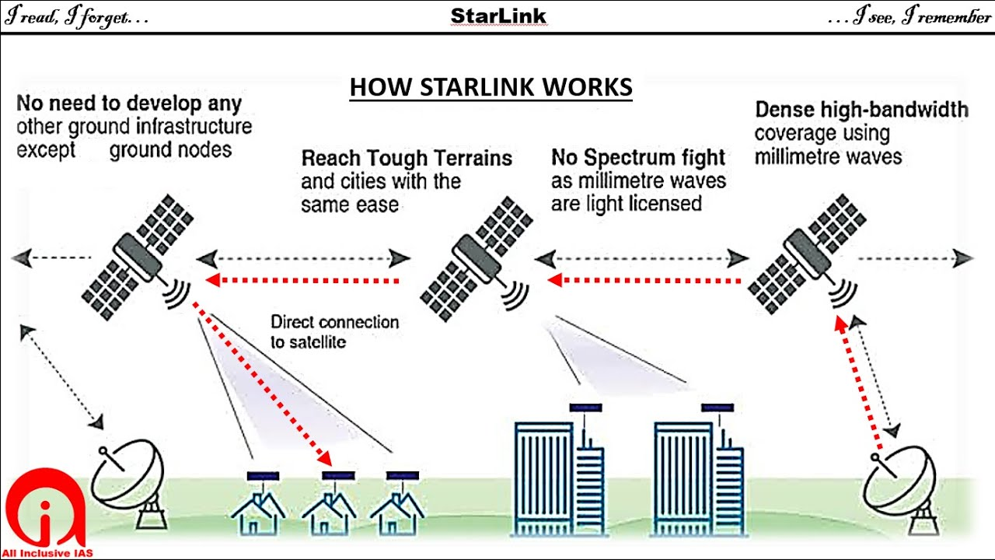
22

Slide 23
Advantages of Starlink
23
Starlink offers several advantages over traditional broadband internet services, including:
Low Latency: Starlink satellites are positioned in low-Earth orbit, which allows for low latency communication between the satellites and user terminals on the ground. This results in faster and more responsive internet connectivity for subscribers.
High Speed: Starlink provides high-speed internet access to subscribers, with speeds up to 100 Mbps. This makes it ideal for a wide range of internet-based activities, including streaming video, online gaming, and teleconferencing.

Slide 24
24
Availability in Remote Areas: One of the primary benefits of Starlink is its ability to provide internet access to remote and underserved areas where traditional broadband services are not available. With a network of satellites in low-Earth orbit, Starlink can deliver internet access to users in even the most remote locations.
Reliability: Starlink’s satellite network is designed to be highly resilient and redundant, with multiple satellites providing coverage for each geographic region. This helps to ensure reliable and consistent internet connectivity for subscribers, even in the event of a satellite failure.

Slide 25
25
Flexibility: Starlink user terminals are compact and portable, which makes them easy to install and use in a wide range of locations. This allows subscribers to access the internet from virtually anywhere, whether they are at home, in a remote location, or on the move.
Affordability: Starlink’s low-Earth orbit satellites and innovative user terminal technology help to keep costs low, making it an affordable option for many users who are looking for high-speed, low-latency internet access.

Slide 26
Competition and Challenges
26
Starlink faces competition from several other companies and technologies that are working to provide satellite-based internet services. Some of the key competitors include:
OneWeb: OneWeb is a global communications company that is developing a low Earth orbit satellite network to provide internet access to remote and underserved communities around the world.
Amazon Project Kuiper: Amazon is working on a low Earth orbit satellite constellation that will provide high-speed, low-latency broadband internet to people globally.

Slide 27
27
Telesat: Telesat is a leading global satellite operator that provides satellite-based communication and broadband services to customers around the world.

Slide 28
Conclusion
28
In conclusion, Starlink is a satellite-based internet service provided by SpaceX that is currently in beta testing with plans to expand coverage around the world.
The service faces competition from other companies and technologies, as well as technical and regulatory challenges, but has the potential to have a significant impact on internet access, communication, education, and commerce in remote and underserved areas.
Overall, I believe that the future of Starlink and satellite-based internet is promising and has the potential to have a positive impact on the world.
Starlink has more benefits than conventional satellite, cellular and cable internet ,that's why we should embrace this internet.

Slide 29
References

